Slide 2
Java 8 Features
Trung nguyen
Kms technology vietnam

Slide 3
Java version history
JDK 1.1 (1997)
JDK 1.2 (1998)
J2SE 1.3 (2000)
JDK 1.0 (1996)
inner classes
strictfp keyword
JNDI, JPDA
Swing API, Collections API
JavaBeans, JDBC, RMI, reflection, JIT
J2SE 1.4 (2002)
assert keyword
J2SE 5.0 (2004)
generics, annotations, enum, varagrs
Java SE 6 (2006)
Java SE 7 (2011)
try statement, invokedynamic in JVM
String in switch, diamond operation
Performance improvements
Scripting Language, Java Compiler API
Image IO API, Java Web Start
Java 8 features

Slide 4

java 8 RELEASE (mar 18, 2014)
Java 7
Default Methods
Stream API
New Date/Time API
Nashorn
Java 8
Lambda Expressions
Others
Java 8 features

Slide 5
Lambda expressions
Default Methods
Stream API
New Date/Time API
Nashorn
Java 8
Lambda Expressions
Java 7
Others
Java 8 features

Slide 6
Lambda Expression
Lambda Expressions are functions without declaration of access modifier, return value declaration, and name
Functions in Functional Programming
Are arguments, return values from other functions
Are variables and be able stored in data structures
Functions in Java
No new types such as function types
Functional Interfaces: are interfaces with exactly one method
java.util.function package Consumer, Function, Predicate, Supplier, BiFunction, DoubleConsumer, IntPredicate, LongSupplier, …
Java 8 features

Slide 7

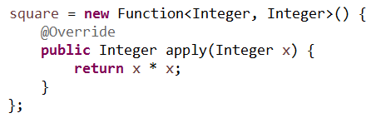

Lambda expression Syntax in java
(arguments) -> { body }
anonymous inner class
lambda expression
single-line lambda expression
no-parameter lambda expression
Java 8 features

Slide 8

Method references
Lambda expressions only call an existing method
Reference to a static method
// int Comparator.compare(T t1, T t2)
Reference to an instance method of a particular object
// void Consumer.accept(T t)
Reference to an constructor
// T IntFunction.apply(int value)
Java 8 features

Slide 9

Why Lambda Expressions in Java?
Encourage functional programming
Easier to distribute processing of collections over multiple threads
More succinct and clear than anonymous inner classes
Is Lambda Expression a syntactic-sugar for Anonymous Inner Class?
Java 8 features

Slide 10
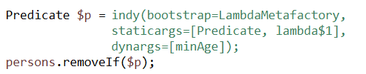

How lambda expressions work?
The lambda expression is represented by a new method, and is invoked at run-time using invokedynamic & LambdaMetafactory
JVM translation
JVM generation
Lambda Expression is not a syntactic-sugar for Anonymous Inner Class
Java 8 features

Slide 11
Stream api
Java 7
Default Methods
Stream API
New Date/Time API
Nashorn
Java 8
Lambda Expressions
Others
Java 8 features

Slide 12

Definition of Stream
Streams are a FP design pattern for processing sequences of elements sequentially or in parallel
Java 8 features

Slide 13
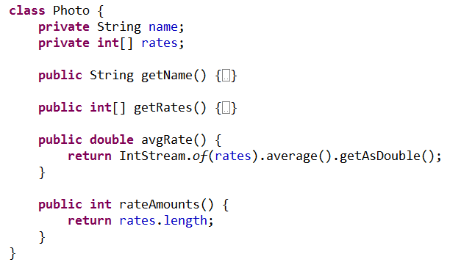
Stream in java 8 - example
Given a list of photos, I want to find 5 photo names that follow top 3 photos whose average rating is higher than 6, sorted by rating and the total amount of ratings given
Java 8 features

Slide 14
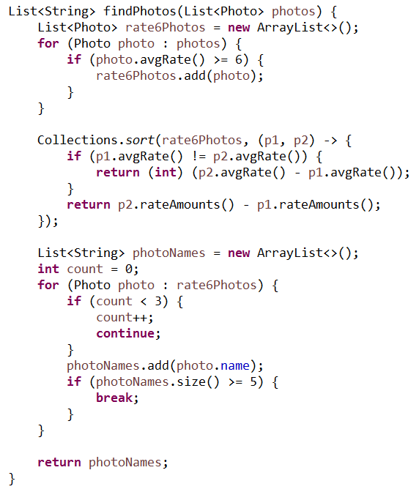
Imperative style
Java 8 features

Slide 15
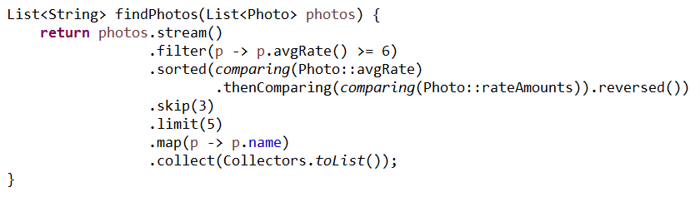
stream style
Coding in Stream API-way
Internally iterates through the elements
Manipulate the collection data easier and faster
Focus on "what" to do instead of "how" to do it
The ability to use multiple processor cores for collection processing
Java 8 features

Slide 16
Stream operations
Intermediate operations
- Lazy processing
- Stateless: filter, map, flatMap, peek
- Stateful: distinct, sorted, skip
- Short-circuiting : limit
Terminal operations
- Eager processing
- forEach, reduce, collect, max, count
- Short-circuiting: anyMatch, allMatch, noneMatch, findFirst, findAny
- Escape-hatch: iterator, spliterator
Java 8 features

Slide 17
Default methods
Java 7
Default Methods
Stream API
New Date/Time API
Nashorn
Java 8
Lambda Expressions
Others
Java 8 features

Slide 18
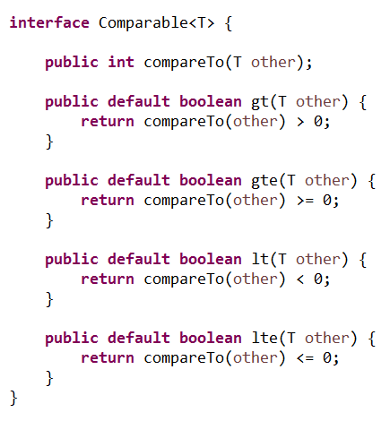
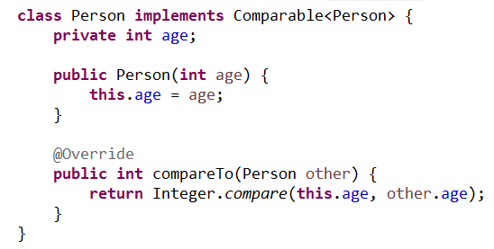
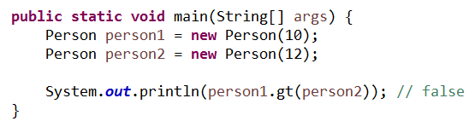
Default methods
How to add forEach(Consumer) method into List interface?
persons.forEach(person -> personRepo.save(person));
Default Methods allow to add default implementations to new and/or existing methods of existing interface
Java 8 features

Slide 19
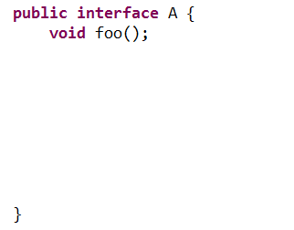
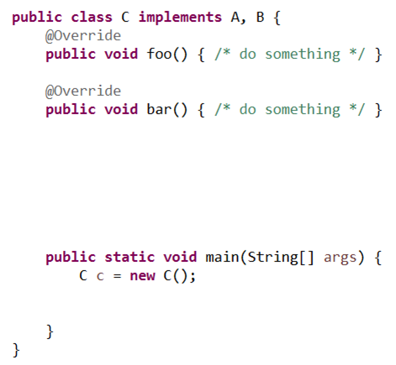


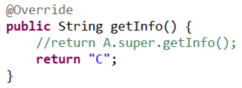
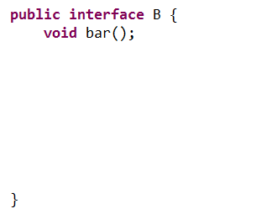



Class-extended in java 8
Multiple Inheritances ← behaviors only, no state
‘Diamond Problem’ ← Solving manually
Java 8 Features

Slide 20
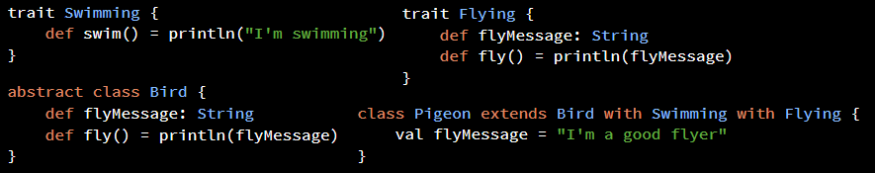
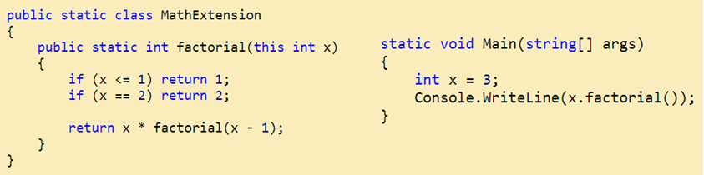
Class-extended in other languages
Scala Traits (or Ruby Mix-ins)
C# Extension Methods
Java 8 Features

Slide 21
New date & time api
Java 7
Default Methods
Stream API
New Date/Time API
Nashorn
Java 8
Lambda Expressions
Others
Java 8 features

Slide 22
date and time api
Problems of current Date Time API
Date, Calendar and SimpleDateFormatter are not thread-safe
Poor API design: years start at 1900, months start at 0
No Non-timezone dates/times, durations, periods and intervals
Joda-Time
Great but not a Java Standard API
New Date and Time API
Immutable-value classes
Domain-driven design
Separation of chronologies
Java 8 Features

Slide 23
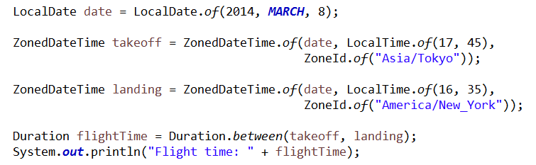
New date and time api example
Domain-driven Date and Time
Date and Time API classes
LocalDate, LocalTime, LocalDateTime, ZonedDateTime
Clock, Duration, Period, ZoneId, ZoneOffset
Java 8 Features

Slide 24
New javascript engine (nashorn)
Java 7
Default Methods
Stream API
New Date/Time API
Nashorn
Java 8
Lambda Expressions
Others
Java 8 features

Slide 25
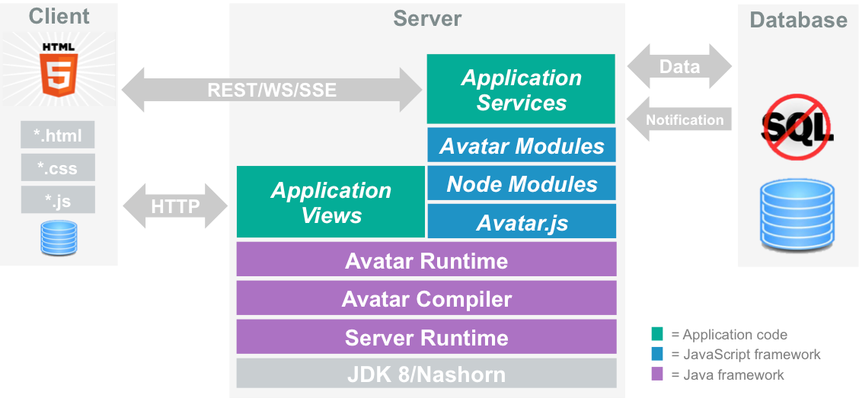
New JavaScript Engine (NASHORN)
Why Nashorn Engine?
Full 100% ECMA262-compliant (edition 5.1)
Compiles JS to Java byte-code based on invokedynamic
Not match V8 performance, but 2-10x faster than Rhino
jjs command line tool
Applying Nashorn: Avartar.js and Project Avatar
Java 8 Features

Slide 26
Other features
Java 7
Default Methods
Stream API
New Date/Time API
Nashorn
Java 8
Lambda Expressions
Others
Java 8 features

Slide 27
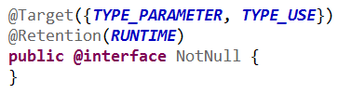

Other features
Static Methods on Interfaces
At beginning, Java allows static fields and static inner types in interface, why not static methods? Yes, it is in Java 8
Optional Class
Type Annotations
3rd-parties like Checker Framework use Java Compiler Plug-in and Pluggable Annotations Processing APIs to develop their own analyses
Java 8 Features

Slide 28
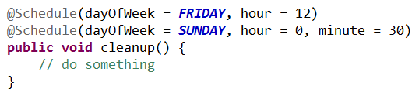
Other features (con’t)
Repeating Annotations
Method Parameter Reflection
How to get name of method parameters?
java.lang.reflect.Executable.getParameters
Compile the source file with the -parameters
Java 8 Features

Slide 29
Conclusions
New Features in Java 8
Default Methods
Stream API
New Date/Time API
Nashorn
Lambda Expressions
Others
Change the way we write applications
Java 8 features

Slide 30
Resources
http://www.oracle.com/technetwork/java/javase/8-whats-new-2157071.html
http://www.techempower.com/blog/2013/03/26/everything-about-java-8/
http://www.takipiblog.com/2014/03/18/5-features-in-java-8-that-will-change-how-you-code/
http://java.dzone.com/articles/think-twice-using-java-8
http://www.infoq.com/articles/java-8-vs-scala
Duke 8 image [http://www.takipiblog.com/]
Stream image [http://ricianh.blogspot.com/]

Slide 31
Questions
Java 8 features

